Slide 1

Risk & Asset Analysis
Building a Resilient Security & Fencing System for a Sustainable Mango Supply Chain in Burkina Faso
Prepared by Tania | Systems Engineering Consultant
Burkina Faso Export Facility

Slide 2
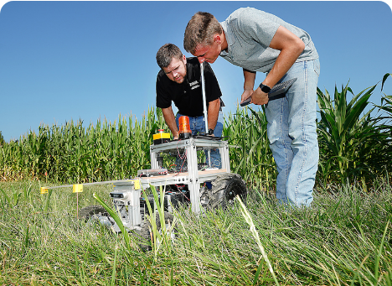










Why Perform a Risk & Asset Analysis?
BEFORE DESIGNING
Avoid arbitrary specs and wasteful capital expenditure
Understand the Environment
Assess extreme weather, remote power grid, and operational site realities
Identify Critical Assets
Map core physical, human, and processing infrastructure requiring defense
Analyze & Prioritize Threats
Quantify vulnerabilities across climate, human, and supply chain vectors
Site Analysis Drives Design
Systems engineering mandates that every physical barrier, sensor, and perimeter gate directly responds to a documented operational threat.
Make Better Engineering Decisions
Drive physical fencing and sensor specs directly from verified risk profiles

Slide 3
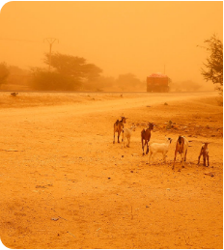
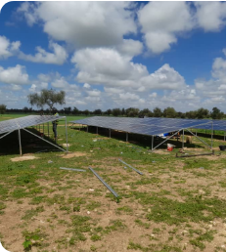


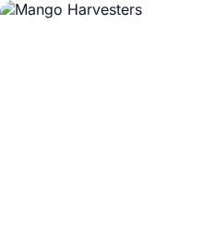
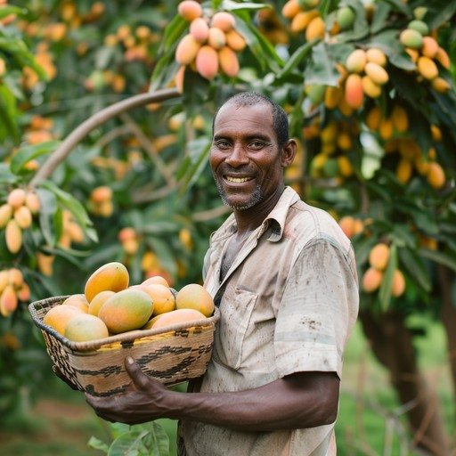
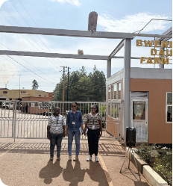


The Operating Environment
Environmental
Infrastructure
Ambient temps exceeding 42°C
Frequent grid power outages
Harmattan fine dust events
100% solar microgrid reliance
Heavy monsoon downpours
Intermittent cellular coverage
Seasonal bushfire threats
Isolated rural location
Operational
Security Target
150+ seasonal harvest staff
High-value organic cargo
High truck throughput periods
Solar microgrid assets
Perishable export windows
Life safety for workforce
Continuous daily handling
Cold-chain continuity

Slide 4



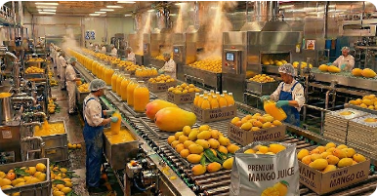




Critical Farm Assets
CENTRAL CORE
SUSTAINABLE MANGO HUB
Export Packhouse
Workforce & Guests
Cold storage & packing line
150+ staff & guest safety
Main Entrance Gate
Agricultural Machinery
Vehicle & visitor access point
Tractors & harvesting tools
Solar PV Microgrid
Logistics Fleet
Primary energy & battery core
Export transport vehicles
Protected System Perimeter & Operational Integrity

Slide 5










Identified Risk Categories
Human Risks
Climate Risks
Infrastructure Risks
Unauthorized perimeter breach
Extreme thermal stress (>42°C)
Grid power blackouts
Cargo theft during harvest peak
Lens degradation from dust
Solar microgrid inverter surge
Operational Risks
Environmental Risks
Supply Chain Risks
Gate congestion during harvest
Seasonal bushfire encroachment
Export delay from security hold
Accidental equipment damage
Flash flooding near access roads
Cold storage breach & spoilage

Slide 6
Risk → Engineering Decision
Extreme Heat
Outdoor Rating Requirement
Industrial IP67 / Sunshield
Harmattan Dust
Optical Cleaning Capability
Wiper-Equipped CCTV
Power Outages
Off-Grid Reliability Spec
Dedicated Solar UPS
Perimeter Intrusion
Delay Time Specification
3D Mesh + Razor Wire
Cargo Spoilage/Theft
Real-time Access Logging
RFID & Biometric Gate
Bushfire Risk
Thermal Buffer Clearance
10m Vegetation Firebreak

Slide 7










How Our Engineering Process Works
3. Risk Identification
4. Risk Assessment
5. Engineering Decisions
6. Week 4 Analysis
1. Farm Context
2. Critical Assets
Climate, infrastructure & operational parameters
Packhouse, solar grid & personnel mapping
Documenting environmental & threat vectors
Severity, likelihood & impact scoring
Selecting fences, sensors & access hardware
Translating into functional sub-system specs

Slide 8
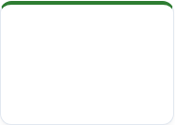
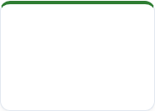

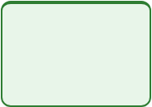




Transition to Week 4
WEEK 1
WEEK 2
WEEK 3 • CURRENT
WEEK 4 • NEXT STEP
WEEK 5
WEEK 6
Lessons Learned
Engineering Strategy
Risk & Asset Analysis
Functional Analysis
Security Zoning
Physical Design
Foundational analysis
High-level system goals
Decomposing sub-system specs
Perimeter & interior zones
Final CAD & BOQ deliverables
Environmental & threat mapping
Bridging Risk Analysis to System Engineering
With our assets inventoried and operational risks prioritized, Week 4 breaks down the security system into functional requirements—defining exactly what each fence segment, gate barrier, and sensor array must perform.

Slide 9






Image Sources
https://admissions.purdue.edu/wp-content/uploads/2025/04/AE_Hero.jpg
Source: admissions.purdue.edu
https://daily.jstor.org/wp-content/uploads/2025/04/west_africas_hazardous_winds_1050x700.jpg
Source: daily.jstor.org
https://eco-greenenergy.com/wp-content/uploads/2025/07/WhatsApp-Image-2023-10-06-at-17.10.07-1.jpeg
Source: eco-greenenergy.com
https://images.stockcake.com/public/e/8/e/e8ea7f08-8a11-46b0-b3ba-24bdb55fca48_large/farmer-holding-mangoes-stockcake.jpg
Source: stockcake.com
https://ugandainvest.go.ug/wp-content/uploads/2026/06/Bwendero-Dairy-Farm-29-scaled.jpg
Source: ugandainvest.go.ug
https://i.ytimg.com/vi/Z59YoIzdG8I/hq720.jpg?sqp=-oaymwEhCK4FEIIDSFryq4qpAxMIARUAAAAAGAElAADIQj0AgKJD&rs=AOn4CLCosLeOgwf5voVTmVePlRRny6x_4Q
Source: www.youtube.com

